Slide 1
Interesting Products Personal Items
Basic 1 – Unit 3 a

Slide 2
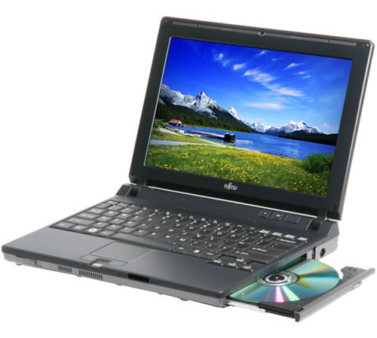
What is this?
It is a laptop

Slide 3
What are these?
They are laptops

Slide 4
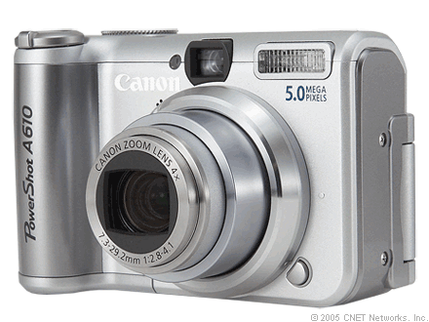
What is that?
It is a digital camera.

Slide 5
What are those?
They are digital cameras.

Slide 6
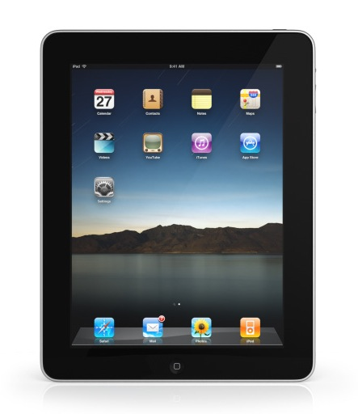
What is that?
It is an iPad

Slide 7
What are those?
They are iPads

Slide 8

What is that?
It is a key.

Slide 9
What are those?
They are keys.

Slide 10
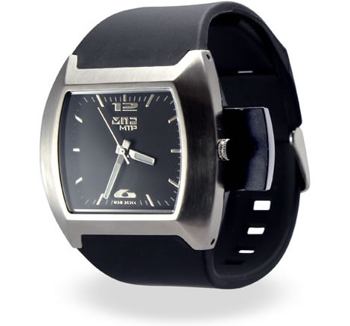
What is this?
It is a watch.

Slide 11
What are these?
They are watches.

Slide 12
Writing Activity

Slide 13
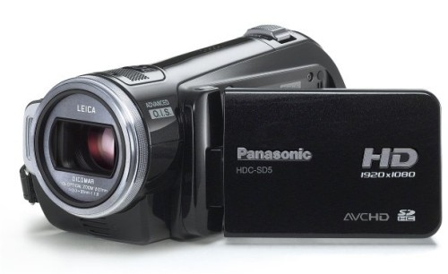
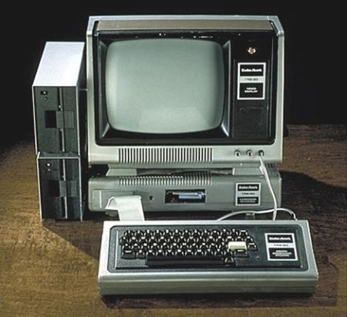
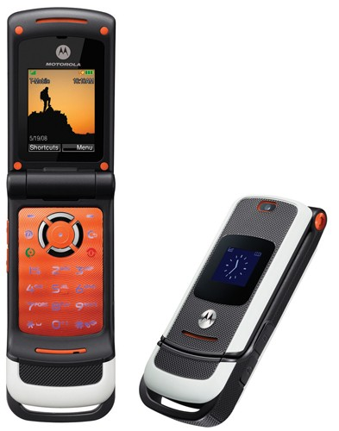
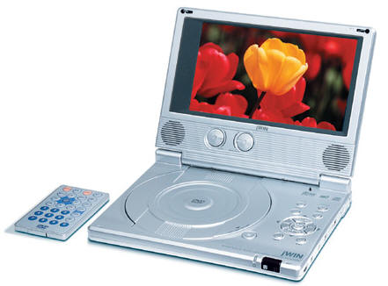
Panasonic - $ 250.00
HP Computer - $500.00
Sony DVD player- $ 690.00
Motorolla- $60.00

